Slide 1
Directable, High Resolution Simulation of Fire on the GPU
As proposed by Christopher Horvath and Willi Geiger Presented by Ben Guitreau

Slide 2
Difficulties in simulating fire
High detail
High velocity due to flickering nature of fire
Turbulence created by large gradients of temperature
Large grid-size in traditional grid-based simulations
Long simulation times

Slide 3
Previous methods, Film/Extraction of fire and smoke
Film and extract fire and smoke elements that are then rendered as camera-facing sprites
Compositing may look believable
Sprites need to be large to be visually effective
Unfortunately, no interaction with environment that is not a part of the original filming
Balrog in “The Lord of the Rings”

Slide 4
Previous methods, 3D Grid with Navier-Stokes equations
Three-dimensional grids using Navier-Stokes equations for velocity, density, and temperature
Augmented with texture details and volume-rendered
Able to interact with environment and simulation is easily directable
Due to large grid-sizes, large amounts of resources and render-time are needed
Hellboy, Hellboy 2, and The Matrix: Reloaded

Slide 5
Proposed method
Makes use of techniques used in both of the previous methods
Particle simulation that stores scalar attributes
Fuel
Mass
Impulse
Allow any user-defined particle behavior as input
Minimum physical criteria enforced by coarse stage
Utilizable by consumer-grade GPUs

Slide 6
Stage One
Coarse grid
Alters the final position and velocity of each particle at the end of the time-step
Enforce incompressibility
Vorticity may be amplified
Axial vector that describes the local rotation of a fluid near a point as it would be seen by an observer located at that point and traveling along the fluid

Slide 7
Stage Two
Evenly-spaced, two-dimensional slices
Particles are projected onto the slices
Represent independent 2D grids on which Navier-Stokes equations are performed on the GPU
Slices are computed across GPU farm

Slide 8







Input Particle System
Requires a visually plausible fluid-like motion
Fully directable, easy to control, and fast enough for many iterations
Attributes:
Vectors: position , velocity
Scalars: radius , mass , fuel , age , impulse
Creating obstacles
Non-zero value for impulse
Zero values for fuel and mass
Time-step
user-defined rules are executed
New velocity computed and integrated to create a new position

Slide 9


Coarse Grid Step
Grid size usually 50 x 50 x 50
Inserted into the update step between calculation of new velocity and position
Augment PIC/FLIP (Particle-In-Cell/Fluid-Implicit-Particle)
Using wavelet decomposition on velocity grid producing multiple levels of detail
Amplifies vorticity
Accelerates convergence of iterative incompressible solution
Incompressibility enforced at each detail level starting at the lowest level and moving upwards
Use Poisson solver with simple Jacobi iterations for solving the non-divergence equation , where is the grid velocity in three dimensions

Slide 10


Coarse Grid Step Algorithm
Computes approximately non-divergent velocity from hypothetical
Create three dimensional axis-aligned uniform grid encompassing particles
Calculate hypothetical new particle velocities from scene forces, collisions, and any other user-defined simulation sculpting
Project hypothetical new particle velocities onto grid
Compute wavelet decomposition of grid into multiple detail levels
for each detail level, from the coarsest to the finest do
Incorporate upsampled new velocities from coarser detail level below
Loosely enforce incompressibility to get roughly divergence-free velocity
Optionally measure and amplify vorticity based on artist specification
end for
Project change in velocity back to particles with artist-specified artificial viscosity

Slide 11
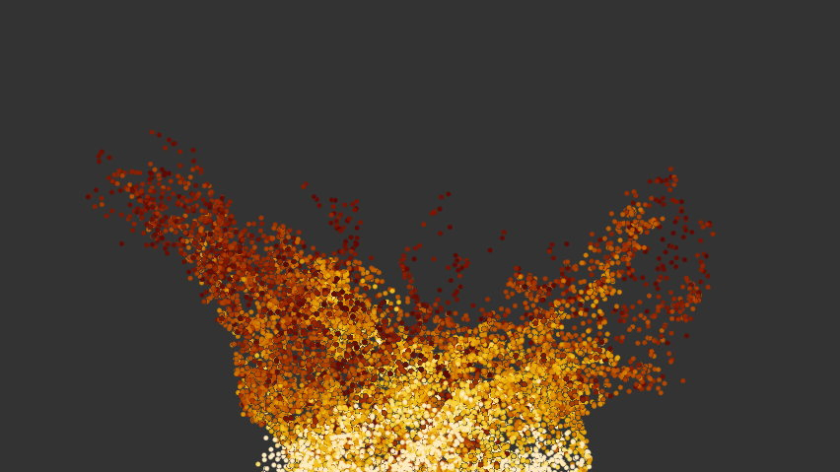
Particles from Coarse Grid Refinement Stage. Coloration is a ramp between yellow and red corresponding to high and low values of particles attributes fuel, density and impulse.

Slide 12
View-Specific Fire Refinement
Conclusion of coarse grid step has produced a computed particle set consisting of position, velocity, radius, fuel, mass, impulse, and age
GPU configuration
Slice Refinement Overview
Particle projection
Cooling, Dissipation, Heating, Density
Boundary Conditions
Semi-Lagrangian Advection
Detail Texture Synthesis
Velocity Damping
Vorticity and Turbulence
Thermal Buoyancy
Enforce Incompressibility

Slide 13
Refinement Simulation Process Algorithm
At each time step, project particles from viewing camera onto slice projection plane to produce forces, additional mass and fuel.
Cool simulation temperature, dissipate simulation density, add new temperature and density from particles.
Enforce simulation edge boundary conditions.
Semi-Lagrangian advect fuel, density, temperature, texture, and velocity.
Add procedural texture to texture plane.
Damp velocity.
Compute vorticity confinement and add turbulence to velocity.
Add thermal buoyancy to velocity.
Enforce velocity incompressibility with Jacobi Pressure solver.
Save data into (density, temperature, texture, fuel) and (velocityU, velocityV) image files.

Slide 14
GPU Configuration
Two-dimensional refinement simulation computed on GPU
Geometry-based graphics processing
GPGPU
NVidia – Cuda
ATI – OpenCL
System built on OpenGL 2.1 using GLSL

Slide 15
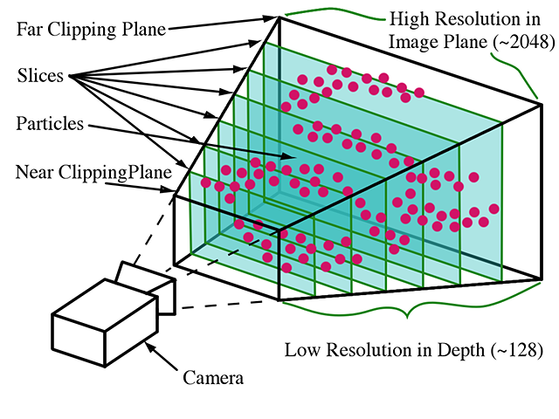
Refinement simulation slices are aligned to the projection plane. They are spaced coarsely and evenly along the projection axis. Slices have very high resolution in the dimension parallel to
the projection

Slide 16
Slice Refinement Overview I
Time-stepped, two-dimensional fluid simulation iterating across a user-defined time-range and solving the incompressible Navier-Stokes equations
Simulation state consists of identical rectangular planes of data
Simulation Data Planes
Inputs from Particles | Particle Fuel Particle Mass Particle Weighted Velocity
Simulation State | Density Temperature Texture Fuel Velocity Artificial Pressure

Slide 17
Slice Refinement Overview II
Each frame produces two four-channel floating-point images per slice
First slice: Density, Temperature, Texture Detail, and Fuel
Second slice: VelocityU and VelocityV
20 substeps per frame to handle a normal range of velocities

Slide 18
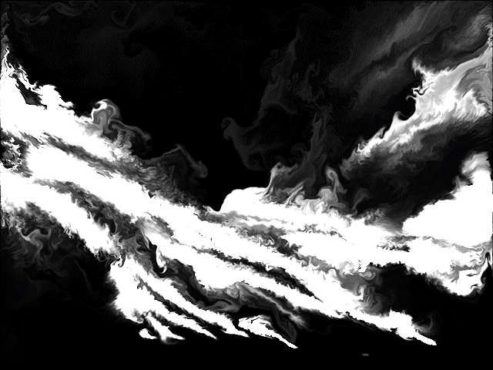
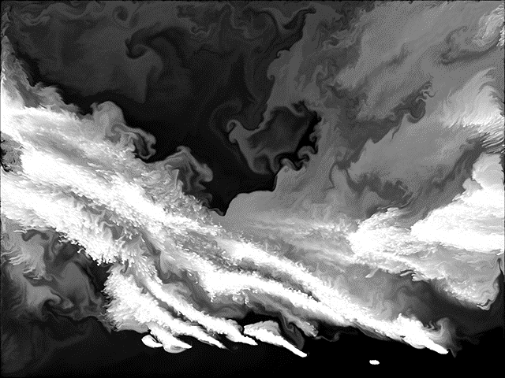
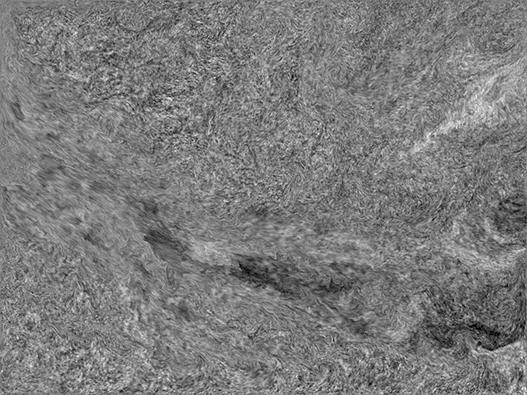
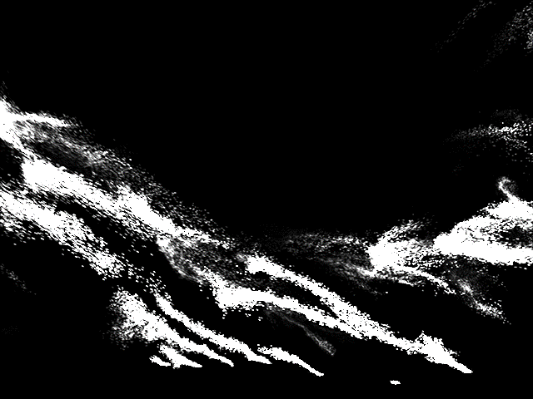
Density
Temperature
Texture
Fuel

Slide 19
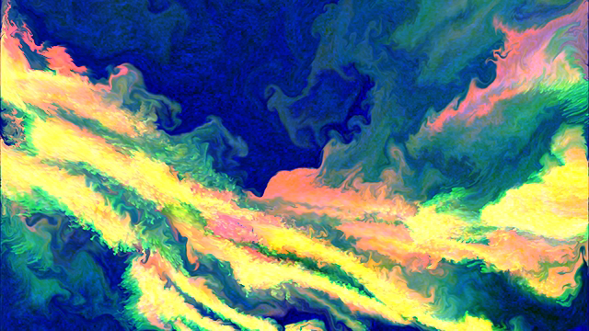
Primary slice refinement output. Combined density, temperature, and texture.

Slide 20

Slice Refinement Overview III
Particle Projection
Particles projected onto refinement slices creating planes
Fuel – adds temperature to system
Mass – adds density
WeightedVelocity – treated as an impulse adding velocity
These planes are used additively
Vertex shader handles matrix transformations
Gaussian weighting kernel
where:

Slide 21


Slice Refinement Overview IV
Cooling, Dissipation, Heating, and Density
First of “slab” operations: two-dimensional planes operated on to create an output data plane
Parallelizable on the GPUs
Cooling
Dissipate
Heating
Density
Where

Slide 22
Slice Refinement Overview V
Boundary Conditions
Collisions taken care of in input particle simulation
Neumann boundary conditions
Semi-Lagrangian Advection
Allows for fluid grid advection steps performed unconditionally and stably for any size time-step
Temperature, Detail Texture, Fuel, and Velocity

Slide 23


Slice Refinement Overview VI
Detail Texture Synthesis
Replace highest frequencies of lost detail
Texture plane is initialized to black
At each time-step, rapidly evolving fractal added to advected texture plane
Noise functions have average value of zero
Set frequency of finest octave of noise in (x,y,t) to Nyquist limit of
Fractal noise has maximum frequency of
For GPU-based noise: 4D Simplex Noise

Slide 24





Slice Refinement Overview VII
Velocity Damping
User-defined damping prior to vorticity, turbulence, and incompressibility calculations
For velocity , timestep , velocity damping coefficient ,
Vorticity and Turbulence
Vorticity confinement and curl-noise turbulence combination for a single step
User-defined noise function uses same Nyquist limits and same style of 4D Simplex noise as in Detail Texture Synthesis

Slide 25




Slice Refinement Overview VIII
Thermal Buoyancy
Update velocity with an upward impulse
For temperature , ambient room temperature , user-defined constant , and direction of user-supplied unit vector :
Enforce Incompressibility
Step One: Divergence calculated on new velocity
Step Two: Artificial pressure term is iteratively solved using a Jacobi solver

Slide 26
Fire Volume Rendering
Volume rendering is performed using a GPU-based renderer
After each slice is computed fully and saved to disk for every frame of every slice
Each slice is already camera oriented and aligned to frustum
Convert temperature to light using Planck Blackbody Radiation
Convert opacity as exponential function of density and spacing between slices
Texture channel selectively used to modulate temperature and density
Fuel not used
Velocity images used in conjunction with semi-Lagrangian advection slab operations
Achieves motion-blur
Redraw stack of slice images continuously into accumulation buffer
Render time for 2000 images approximately 30-40 seconds to load, render, and save
Fire renders composited fully by incorporating holdout mattes during near-to-far rendering
Heat distortion effect is a post-process

Slide 27
Simulation
Three simulations
25000 particles in coarse grid simulation
Between 50 and 200 frames
Took no longer than 10 minutes to execute and save to disk
Refinement slice resolution of 2048 x 1556
Farm:
NVidia Quadro 5600 GPUs
2.2 GHz AMD Dual-Core Opteron
SUSE Linux 9.3.1
Timing:
10 seconds per frame per slice on 10 GPUs
2 to 4 hours per simulation plus 1 to 2 hours for rendering

Slide 28

Fast moving fireball with sparks

Slide 29

Twisting campfire with rotation

Slide 30
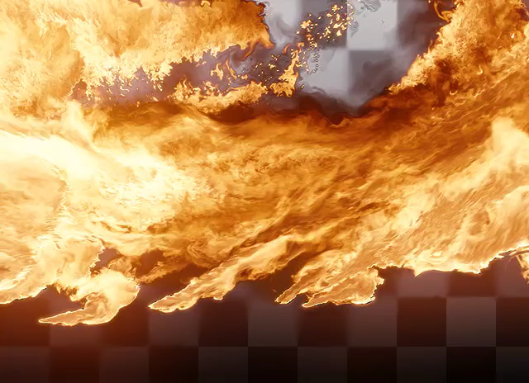
Wall of fire

Slide 31
Conclusions
Used on three feature films as of paper authoring
Artist learning curve is small
Short turnaround time for large, high-resolution simulations
With increasing GPU storage and speed, simulations should be able to be completed using 1 machine and 1 GPU

